Slide 1


Slide 2


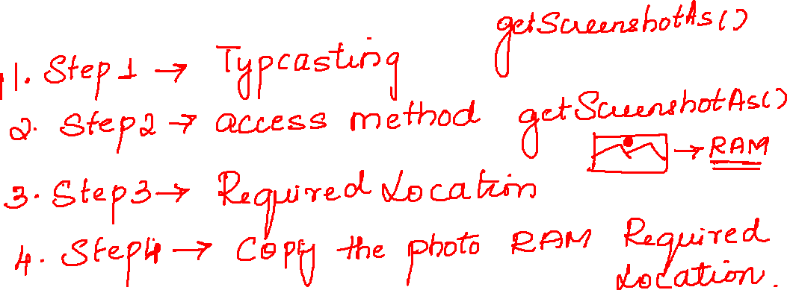

Slide 3
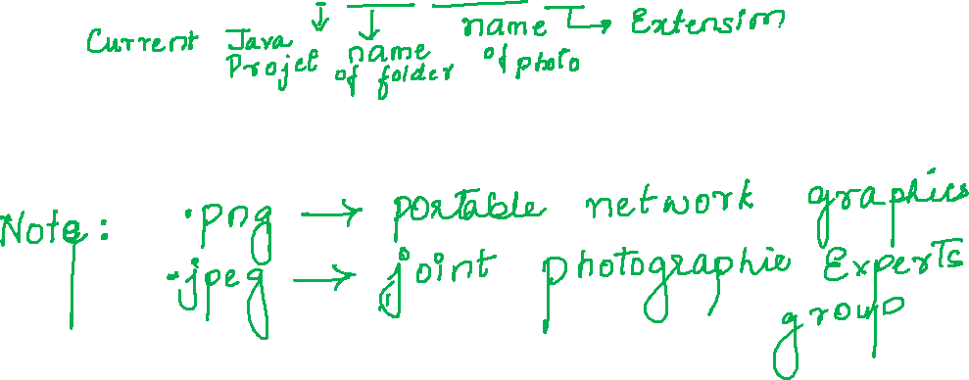
//typcasting
TakesScreenshot ts=(TakesScreenshot) driver;
//access the method and photo is stored in RAM
File src = ts.getScreenshotAs(OutputType.FILE);
//specify the location
File dest=new File("./photo/flipkart.png");
//copypaste from ram to required location
FileUtils.copyFile(src, dest);

Slide 4


Slide 5
